Slide 1
MyRocksDB for MySQL
An Introduction to MyRocks

Slide 2
MyRocks
Issues in InnoDB

Slide 3
Why MyRocks-InnoDB
Random Write on B+ tree(Random Acessing)
Insert into table values (xxx) ;
Insert into table values (yyy);
xxx
3|4
yyy
3|4

Slide 4
Why MyRocks-MyRocks
InnoDB
Writing amplification.
More redundant Data
be Written

Slide 5
Why MyRocks-InnoDB
Storing data in InnoDB
B+ Tree,
data in sequential order (Best)
Or get fragmentation.
3
2
2
1|2
3|4
1|2
3
4
1,2,3,4
3,1,4,2

Slide 6
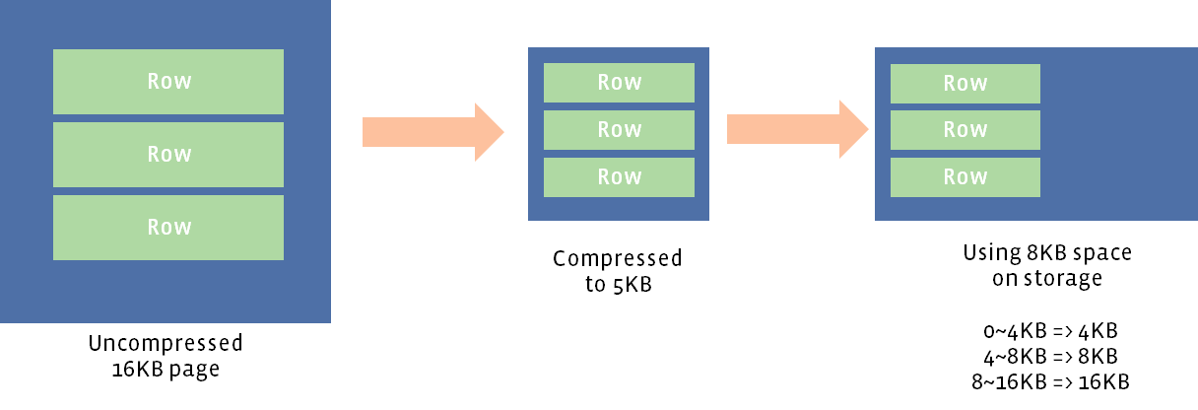
Why MyRocks-InnoDB
Compression
Original size 16k ---→ 5k Compressed -→ 8k on OS.
3k/Page wasted.

Slide 7
Conclusion On Data Space For InnoDB.
Space Amplification In InnoDB
HHD
SSD
More random accessing
More Cost to infrastructures.
More IOs

Slide 8
MyRocks
Solutions of MyRocks.

Slide 9
Why MyRocks-MyRocks
LSM Tree
 |  | Avg. | Worst Case
Insert |  | O(1) | O(1)
Find |  | O(N) | O(N)
Delete |  | O(N) | O(N)
https://github.com/sears/bLSM/ LSM incorporates B+ tree.

Slide 10
Why MyRocks-MyRocks
LSM Tree
 |  | Avg. | Worst Case
Insert |  | O(1) | O(1)
Find |  | O(N) | O(N)
Delete |  | O(N) | O(N)
https://github.com/sears/bLSM/ LSM incorporates B+ tree.

Slide 11
RocksDB

Slide 12
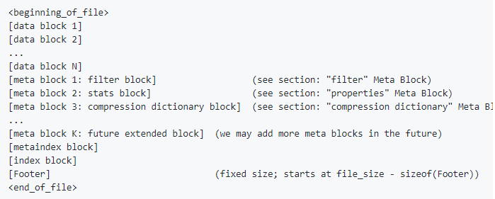
RocksDB
SST file internal format-BlockBasedTable

Slide 13
RocksDB

Slide 14
Why MyRocks-MyRocks
LSM Tree
 |  | Avg. | Worst Case
Insert |  | O(1) | O(1)
Find |  | O(N) | O(N)
Delete |  | O(N) | O(N)
https://github.com/sears/bLSM/ LSM incorporates B+ tree.

Slide 15
Why MyRocks-MyRocks
MyRocks
Append Only.
Changes to WAL, and merges to SST

Slide 16
Why MyRocks-MyRocks

Slide 17
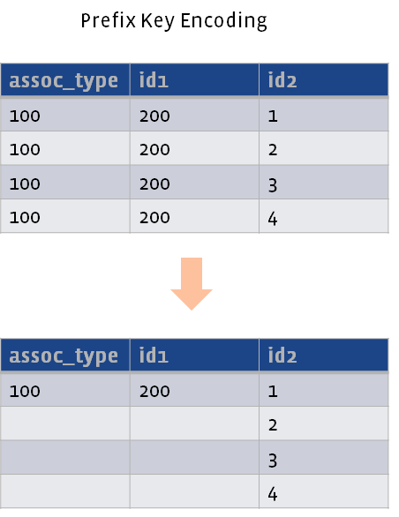
Why MyRocks-MyRocks
Prefix Key encoding
multi-column indexes
storing NOT duplicate prefix

Slide 18
Why MyRocks-MyRocks
Why we need to reduce IOs.
Needed by SSD flash.
IO bottleneck in DB.
Data Volume
Data volume per writing.
Total Writing volume.

Slide 19
Conclusion On Writing Amp.
Saving IOs
More QPS
Shorter Insertion time need.
Shorter Latency.
…

Slide 20
Conclusion On Data Space for MyRocks
Compression
Does compression also.
NO Alignment, Comparing to InnoDB does.
SeqID compressed.
Prefix Key Compression
…
LESS Data Space Needed.

Slide 21
MyRocks Row Format
What’s format of a row in MyRocks.

Slide 22
Why MyRocks-MyRocks
No Row-ID and Rollback ptr In each Row,
Sequential ID and Operation Type.
6 bytes for SeqID
1 byte for Operation Type.
On Primary and Secondary Key.
Fill with 0 to replace SeqID in SST.
InnoDB has.
6 bytes and 7 bytes.
Can not be compressed.
On Primary key
SeqID | … | OperType | …
ROWID | … | Rollback-Ptr | … | Trx_id | … | Rollback-Ptr

Slide 23
Why MyRocks-MyRocks
Internal Index ID
Used for insert/delete/update/search, etc.
RocksDB Key |  | RocksDB Val
Internal index id | Primary key | The rest col.

Slide 24
Why MyRocks-MyRocks

Slide 25
Why MyRocks-MyRocks

Slide 26
MyRocks Features
Features of MyRocks.

Slide 27
MyRocks Features
Features same as InnoDB.
Transaction
MVCC
Read Commited, Repeatable Read
Online Backup
Mysqldump (logical backup)
Myrocks_hotbackup , Python script(binary backup)

Slide 28
Backup Tools
Logical
mysqldump
mysqldump -h 127.0.0.1 -P 3306 --default-character-set=binary --single-transaction --master-data=2
Physical
Python script.
myrocks_hotbackup
[src_host]$ myrocks_hotbackup --user=root --password=pw --port=3306 --stream=tar --checkpoint_dir=$backup_dir | ssh -o NoneEnabled=yes dst_host 'tar -xi -C $dst_host_dir/backup_from_src'
[dst_host]$ myrocks_hotbackup --move_back --datadir=$datadir --rocksdb_datadir=$datadir/.rocksdb --rocksdb_waldir=$datadir --backup_dir=$dst_host_dir/backup_from_src

Slide 29
Multi-Storage Engine.
my.cnf
allow-multiple-engines
skip-innodb (Removed)

Slide 30
Multi-Storage Engine.
my.cnf
allow-multiple-engines
skip-innodb (Removed)

Slide 31
Multi-Storage Engine.
my.cnf
allow-multiple-engines
skip-innodb (Removed)

Slide 32
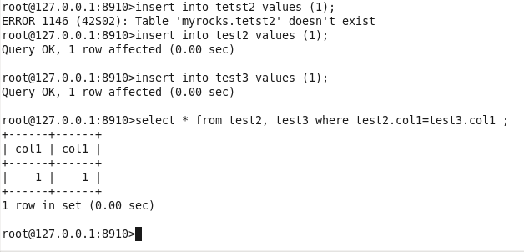
Multi-Storage Engine.
my.cnf
allow-multiple-engines
skip-innodb (Removed)

Slide 33
Data Files
${datadir}/.rocksdb

Slide 34
Data Files
${datadir}/.rocksdb

Slide 35
Data Files
${datadir}/{database_name}
MyRocks
MySQL 5.7.xx

Slide 36
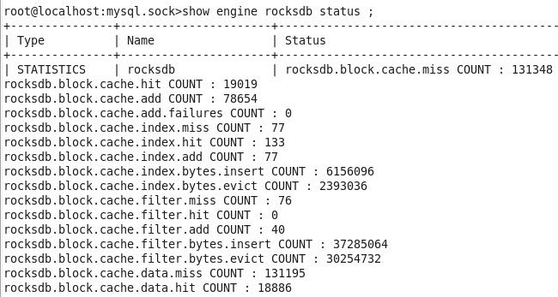
Engine Status
Show engine rocksdb status;

Slide 37
MyRocks Features
Limitations of MyRocks.

Slide 38
Limitation of MyRocks
Compare with InnoDB
Online DDL
Fast alter table and drop index.
DROP_INDEX， DROP_UNIQUE_INDEX和ADD_INDEX(in-place)
Otherwise, rebuild table.
Savepoint
Gap-Lock
Row-base rep MUST, statement base leads to inconsistency .
Order desc is SLOW
Reverse column (double reverse)
COMMENT ’recv:cf__link_id2_type’

Slide 39
MyRocks Features
Test Results.

Slide 40
Data Size
 | MySQL | MySQL Compred. | MyRocks | MyRocks Compred
1Million Rows | 2401 | 1601 | 2151 | 1842
5Million Rows | 11681 | 7801 | 10369 | 5740
10Million Rows | 23281 | 15521 | 20683 | 11746
Unit: MB
MySQL: ROW_FORMAT=COMPRESSED
MyRocks: compression_per_level=kNoCompression:kNoCompression:kZlibCompression:kZlibCompression:kZlibCompression:kZlibCompression:kZlibCompression;compression_opts=-14:2:0

Slide 41
Selection Time
 | MySQL |  |  | MyRocks
 | TPS | QPS | Latency (ms) | TPS | QPS | Latency(ms)
1million rows | 3394.56 | 54312.93 | 29.45 | 9860.49 | 157767.91 | 10.14
5millon rows | 3329.12 | 53265.88 | 30.03 | 9715.81 | 155452.93 | 10.29
10million rows | 3304.66 | 52874.52 | 30.25 | 9605.81 | 153692.99 | 10.41
Sysbench: 100 threads
Oltp-type=read only

Slide 42
Selection Time
 | MySQL |  |  | MyRocks
 | TPS | QPS | Latency (ms) | TPS | QPS | Latency(ms)
1million rows | 3160.16 | 50562.60 | 63.27 | 9467.90 | 151486.37 | 21.12
5millon rows | 3200.27 | 51204.30 | 62.47 | 9544.54 | 152712.7 | 20.95
10million rows | 3208.23 | 51331.70 | 62.32 | 9147.85 | 146365.59 | 21.86
Sysbench: 200 threads

Slide 43
Results
MyRocks
 | Data Size | Complex |  |  | Read Only
 |  | QPS | TPS | Latency | QPS | TPS | Latency
 | 109GB | 7246.88 | 402.56 | 248.37 | 6355.46 | 453.96 | 220.26
Rows: .1billion rows/table
Tables: 10;
Threads:100
Intervals:2

Slide 44
Results
MySQL
 | Data Size | Complex Query |  |  | Read Only
 |  | QPS | TPS | Latency | QPS | TPS | Latency
 | 223GB | 11742.13 | 652.34 | 153.28 | 13578.77 | 969.91 | 103.10
Rows: .1billion rows/table
Tables: 10;
Threads: 100
Intervals: 2 s
Times: 3600s

Slide 45
Results Comparison
Data Space
MySQL 1 VS MyRocks 0.9
Saving about 10%.
MSQL 1 VS MyRocks 0.5 (Comp)
Saving about 50%
All results at 5million rows.
ROW_FORMAT=COMPRESSED (Table Compression)
Page Compression, COMPRESSION="zlib“, supported by OS and FS.

Slide 46
Results Comparison
Insertion Time
MySQL 3+mins VS MyRocks 1+mins
Saving about 60%.
With 5million rows.

Slide 47
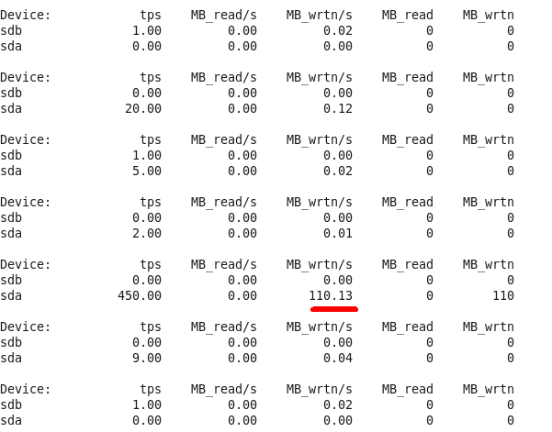
IoStat for MyRocks
10 million rows/ 10 tables
iostat -d -m 1 10

Slide 48
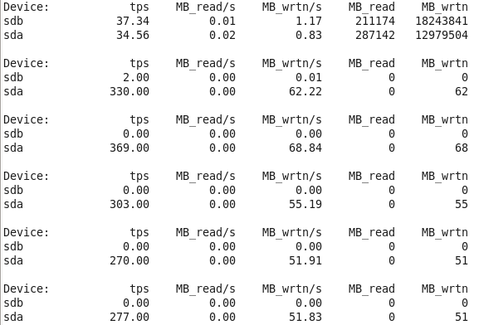
IoStat for MySQL
10 million rows/ 10 tables
iostat -d -m 1 10

Slide 49
Conclusion On Results
Insertion Time
Saving about 60%.
Selection Opers
Data Space
Saving about 10% compare to MySQL 5.7.xx
Not Competitive, with MySQL with Compr. Options On.
Saving about 50% in Compression mode.
IO
Not heavily IO Requests.
Side effect: More CPU needed.
With 5million rows.

Slide 50
Conclusion
MyRocks is OK

